Slide 1
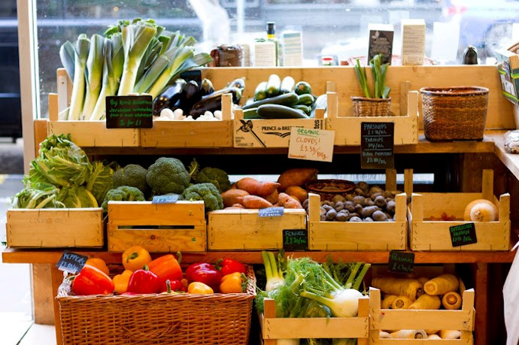
2023
SHARE ISSUE
Melanie Main Mel@diginbruntsfield.co.uk 07775 665499

Slide 2
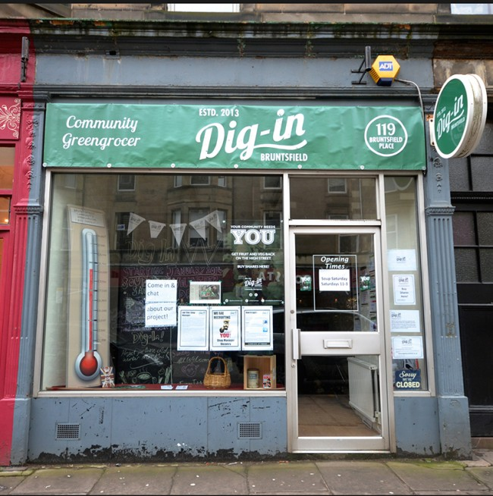
Background
In the beginning
2013 Dig-in set up
raised £30,000 from over 300 people
Shop opened 2014
The first decade
Static membership
Spectacular start
Covid and after
2023 – a new decade

Slide 3
Investment for the future: modernising and renovation
Aiming for £15000
Shop refurbishment £5000
New EPOS £6000
New Chillers £3000

Slide 4
How the Share Offer will work
Target £15,000 Min £10,000 Max £20,000
Wednesday 25th October to Friday 17th November.
Investment Limits: from one share £25 to £3000
Launch 25th October at the Bruntsfield Hotel
Shop stalls, printed material, social media, website
Buy shares on www.diginbruntsfield.co.uk. Paper forms available application forms from the shop or by request to members@diginbruntsfield.co.uk
.

Slide 5
What you can do to help!
Buy shares for yourself and your family or as a gift.
Buy a share to be gifted to one of our volunteers.
Tell your neighbours, friends and colleagues
Share us on social media, follow Dig-In on Instagram
Invite us to come and talk to a group or organisation you know
Visit our website and share our QR code

